Slide 1
Effects of Light Rail Transit Development and Neighborhood Design on Travel Behavior
Jason Cao
cao@umn.edu
With Jessica Schoner and Alireza Ermagun

Slide 2
Introduction
Why do we care about rail transit?
  A growing interest in many regions
Notes:
Purcher and Renee (2003)

Slide 3

“New Starts” PD and Engineering Projects
September 2016 Status
Minneapolis – St. Paul, MN
Seattle, WA
NJ - NY
New York, NY
Hudson, NJ
San Jose, CA
Suburban Maryland
Denver, CO
Los Angeles, CA
Durham, NC
Santa Ana, CA
Phoenix, AZ
Fort Worth, TX
Houston, TX
Fort Lauderdale, FL
Project Development (PD) Engineering

Slide 4
Introduction
Why do we care about rail transit?
  A growing interest in many regions, but
  Substantial subsides
    All capital costs ($B)
    Most operating costs
  Transportation effects of rail transit, among others
    Transit use and driving
Notes:
Purcher and Renee (2003)

Slide 5
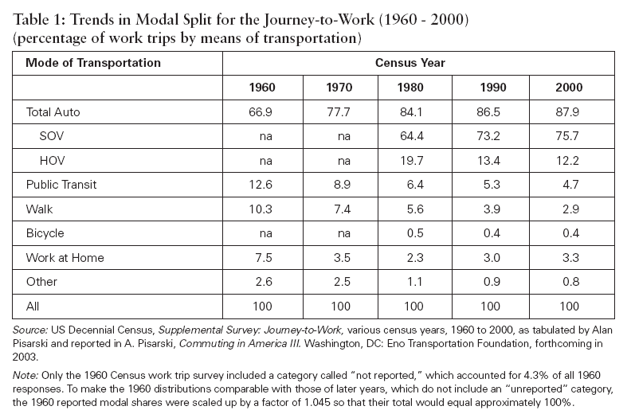
Commute mode split
Purcher and Renee (2003)
Notes:
Purcher and Renee (2003)

Slide 6
Urban Mobility Report
$160 billion
(in 2014)
$960 per commuter

Slide 7


Jackie Chan and Chris Tucker

Slide 8
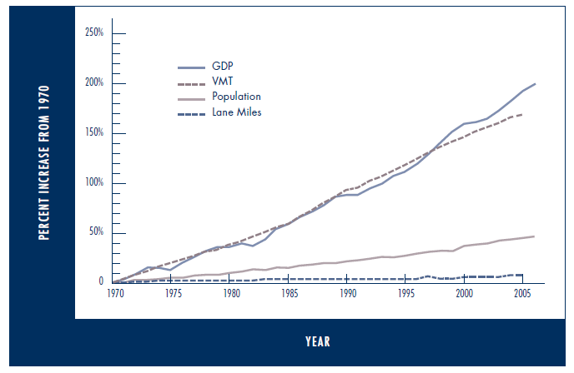
Demand > Supply

Slide 9
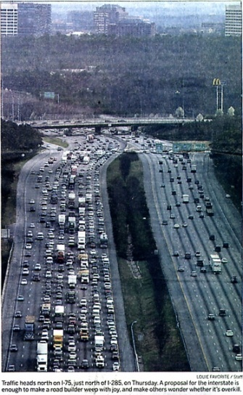
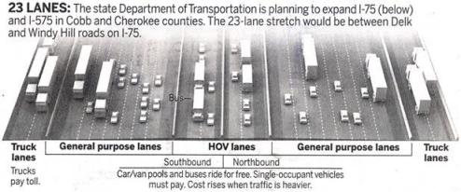
Will 23 lanes be enough?
Proposal would put I-75 among country's biggest
By Ariel Hart
It's wider than an aircraft carrier. Far wider than the carving on Stone Mountain. Wider than the White House stretched end to end, twice.
It's the planned I-75, all 23 lanes, coming soon to Cobb County. As currently conceived it's 388 feet across, wider than a football field is long
Notes:
9
9
Source: Atlanta Journal-Constitution, March 10, 2006

Slide 10
Why did US stop building highways?
Revenue
Cost
Induced demand
Iron law of congestion
  Temporal convergence
  Route convergence
  Mode convergence
We cannot build our way out of congestion.

Slide 11
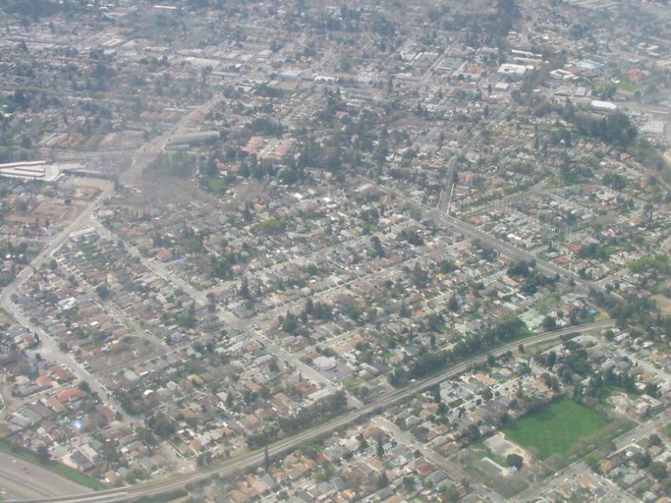
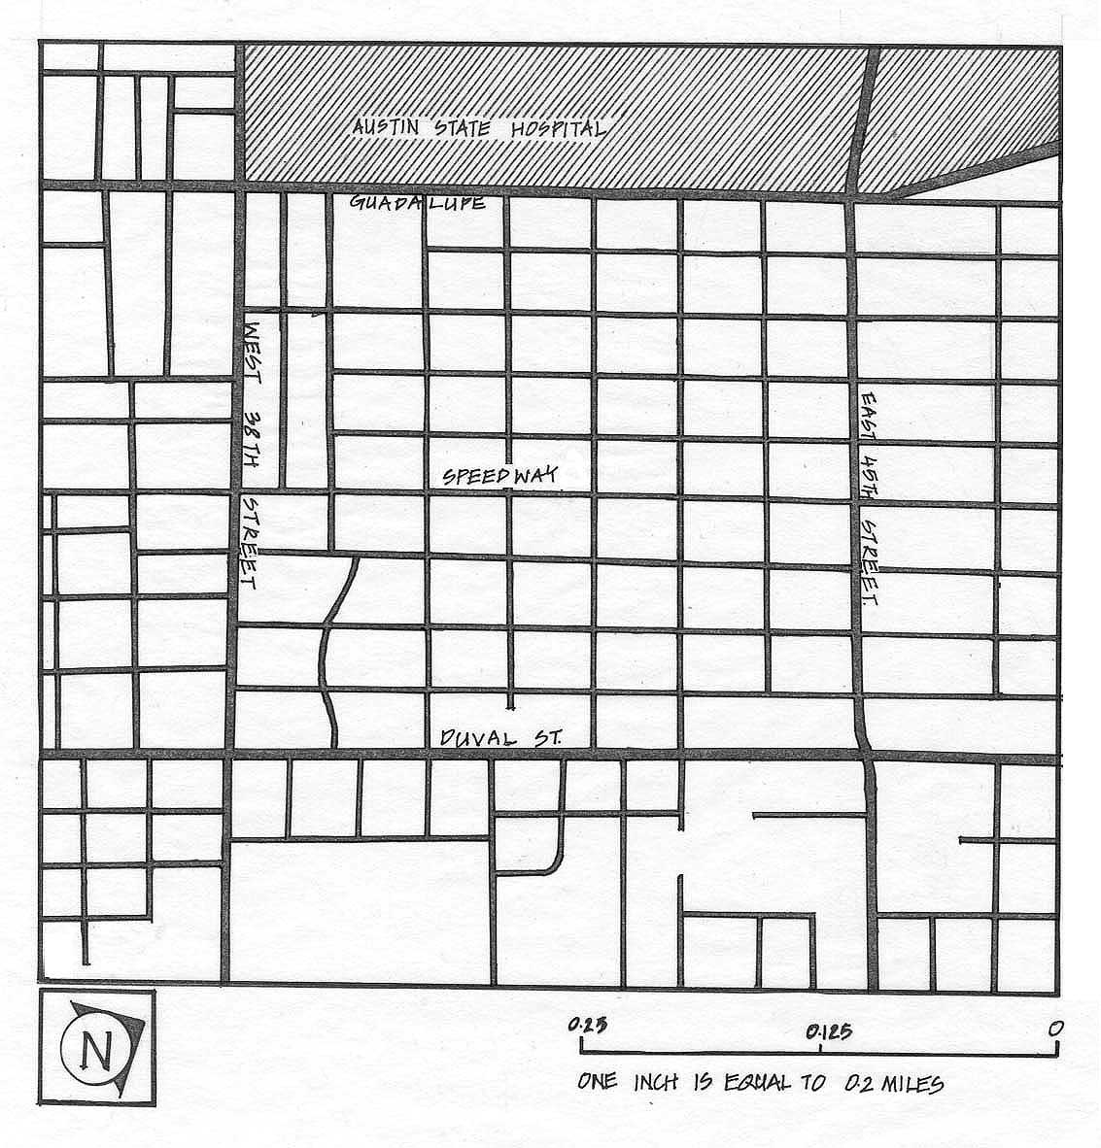
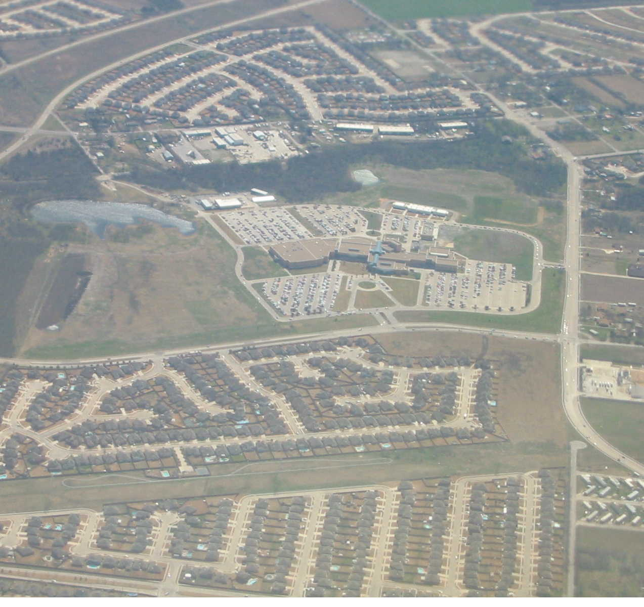
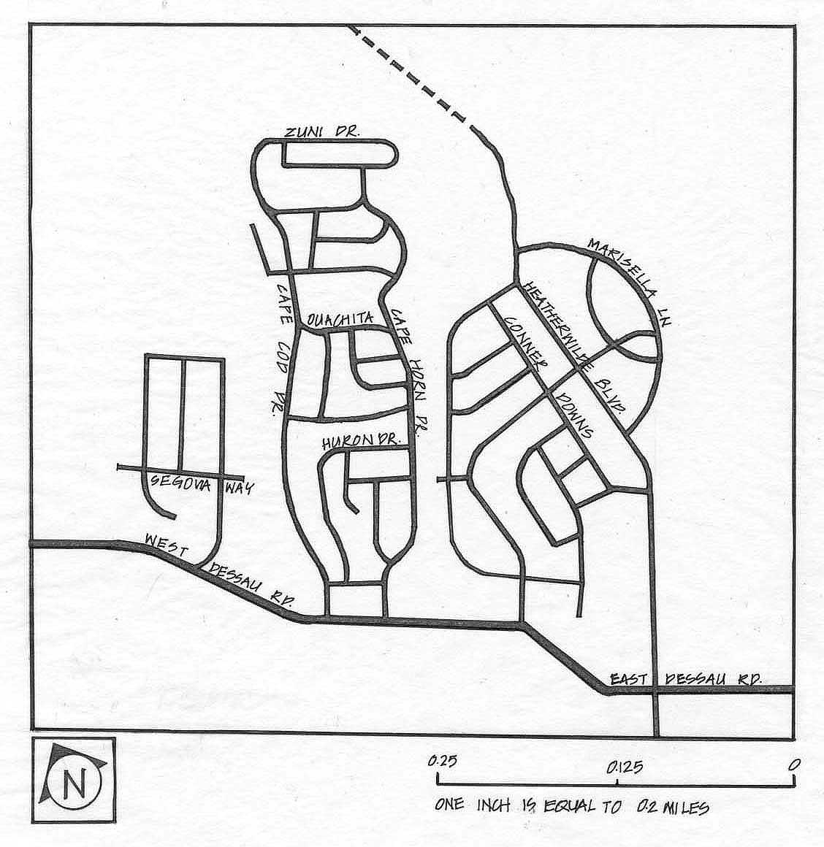
Sprawl → auto dependence

Slide 12
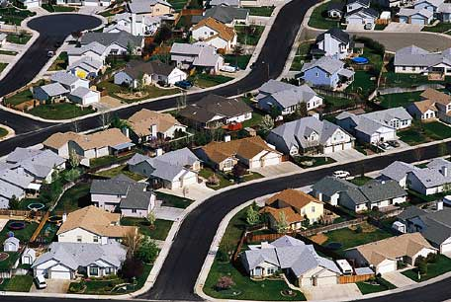
Sprawl
“The landscape sprawl creates has four dimensions: a population that is widely dispersed in low density development; rigidly separated homes, shops, and workplaces; a network of roads marked by huge blocks and poor access; and a lack of well-defined, thriving activity centers, such as downtowns and town centers.”
– Ewing et al. (2002)
Notes:
Typical suburban communities at urban fringes

Slide 13
Alternative developments
Smart Growth Principles (Selected)
Mixed land use
Take advantage of compact building design
Create walkable neighborhoods
Provide a variety of transportation choices
Strengthen and direct development towards existing communities
Foster distinctive, attractive communities with a strong sense of place
Notes:
Smart growth america

Slide 14
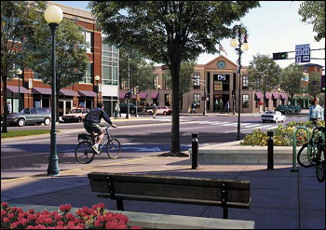
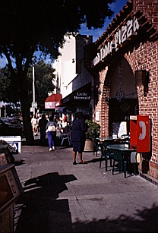
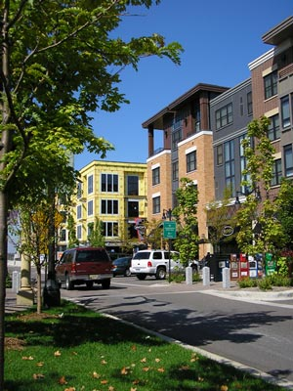
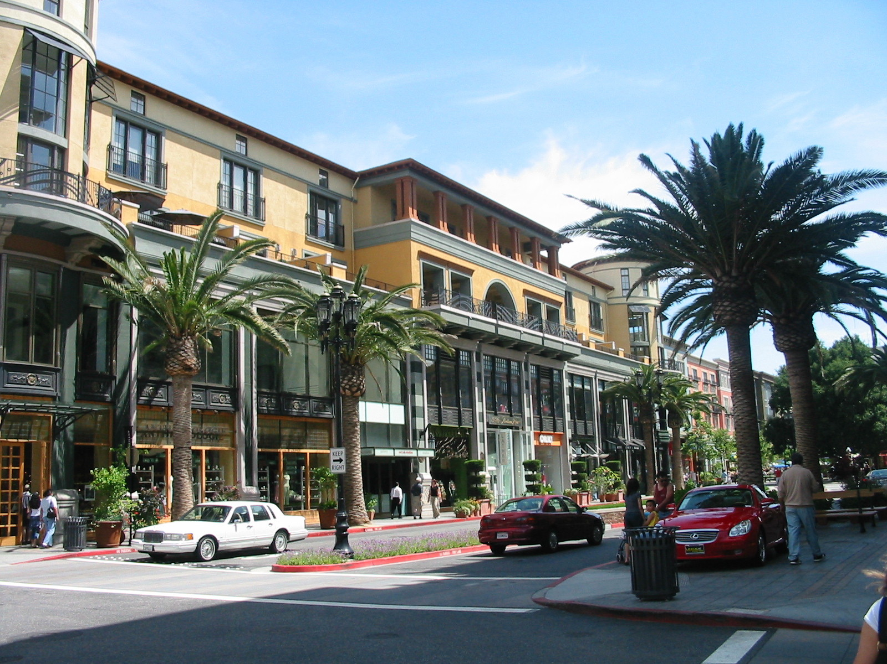
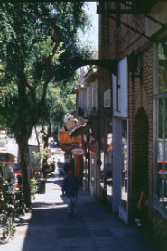
Pedestrian-oriented development

Slide 15
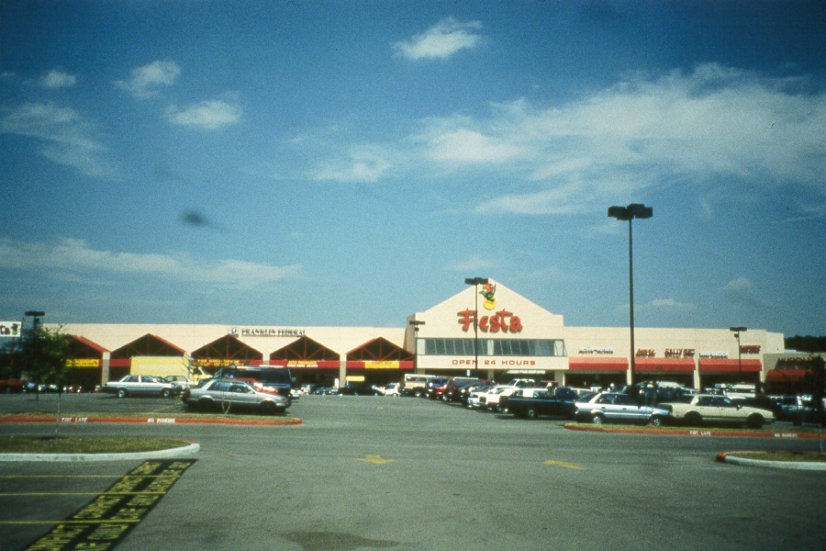
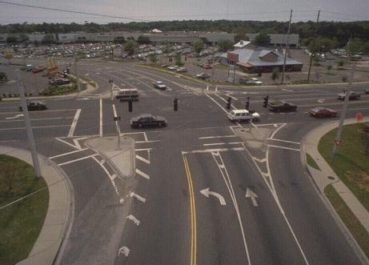
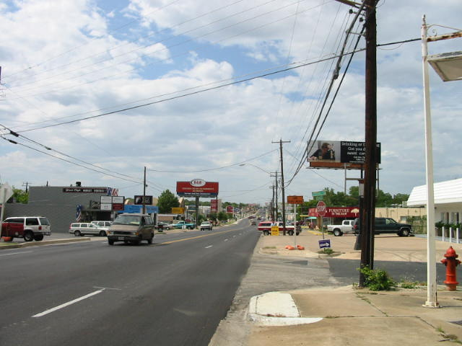
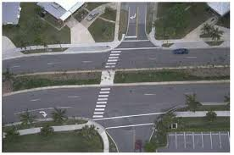
Auto-oriented development

Slide 16
Association
Compare travel behavior of residents in traditional and suburban neighborhoods → association
Residents living in traditional neighborhoods (characterized as high density, high accessibility, mixed land use, etc.)
  Drive less
  Walk more

Slide 17
Research gap I
Compare travel behavior of residents in traditional and suburban neighborhoods → association
Residents living in traditional neighborhoods (characterized as high density, high accessibility, mixed land use, etc.)
  Drive less
  Walk more
Association ≠ causality
Is this association
  due to the built environment itself?
  or due to travel and land use predispositions?
Residential self-selection
Transit-Oriented NBHD
Like Transit
Use Transit More

Slide 18
Research gap II
Is the impact of transit-oriented development (TOD) on travel behavior due to
  light rail transit (LRT) itself, or
    LRT is sufficient.
  characteristics of neighborhoods near LRT?
    Without neighborhood design, LRT is useless;
    This offers guidance for planning practice.

Slide 19
Research gap III
When comparing travel behavior, previous studies often choose region/county/city as a contrast to TODs.
Rail transit often replaces busy bus routes.
  Control: consider regional location, built environment, and transit service
We are likely to overstate the impact of TODs on travel behavior.

Slide 20
Objective
Questions
  Does the Hiawatha LRT lead to an increase in transit use and a reduction in auto ownership and use?
  Do station-area neighborhood attributes affect travel behavior?
Transit use: cross-sectional
Auto use: cross-sectional
Auto ownership, auto use, and transit use: Quasi-longitudinal

Slide 21
Data
Self-administered survey in May 2011
Five neighborhoods
Movers: moving in after its opening
Non-movers: already living there before its opening
22.2% response rate

Slide 22
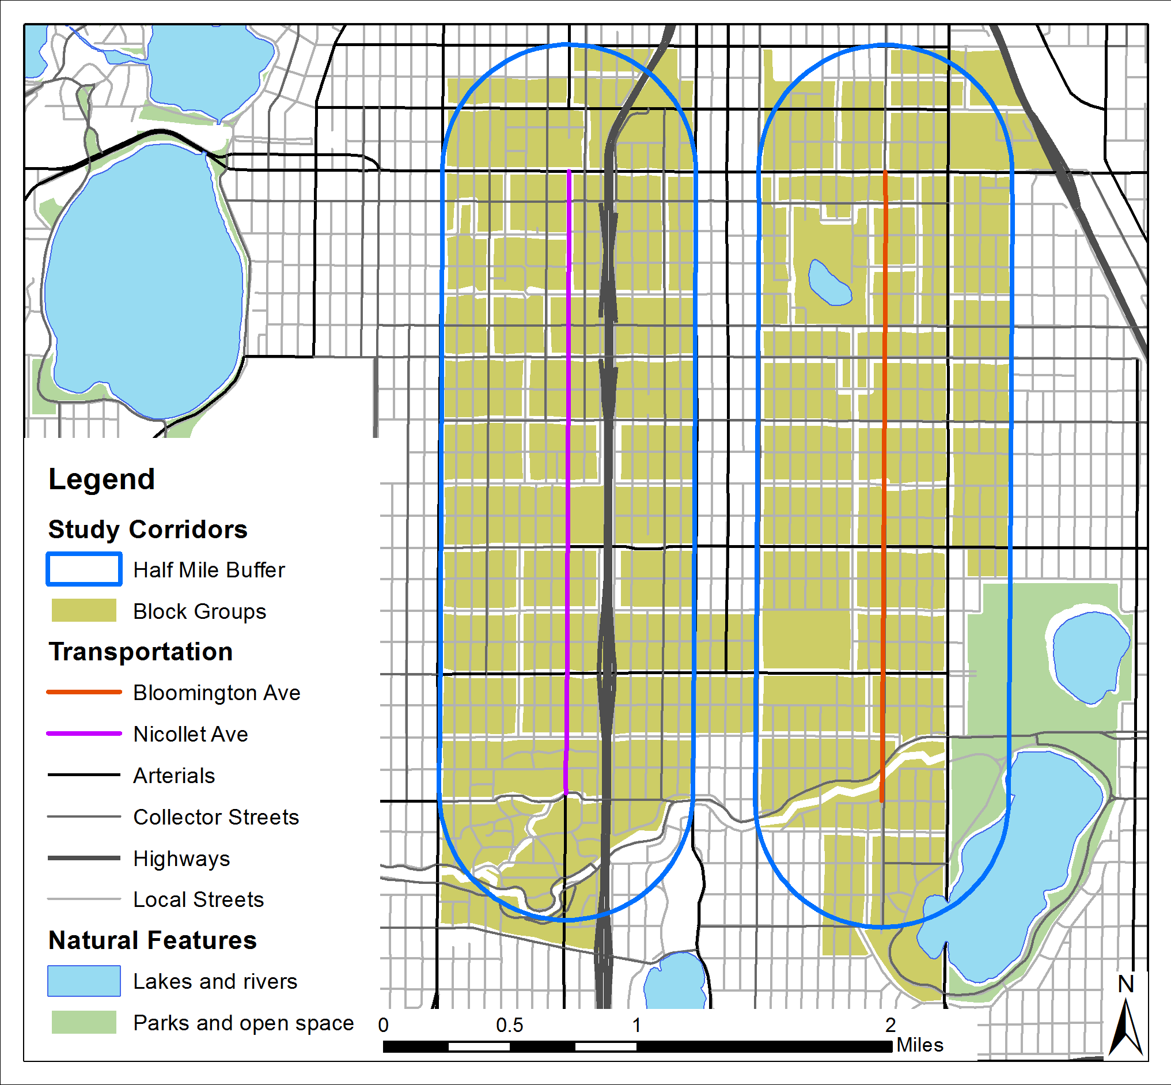
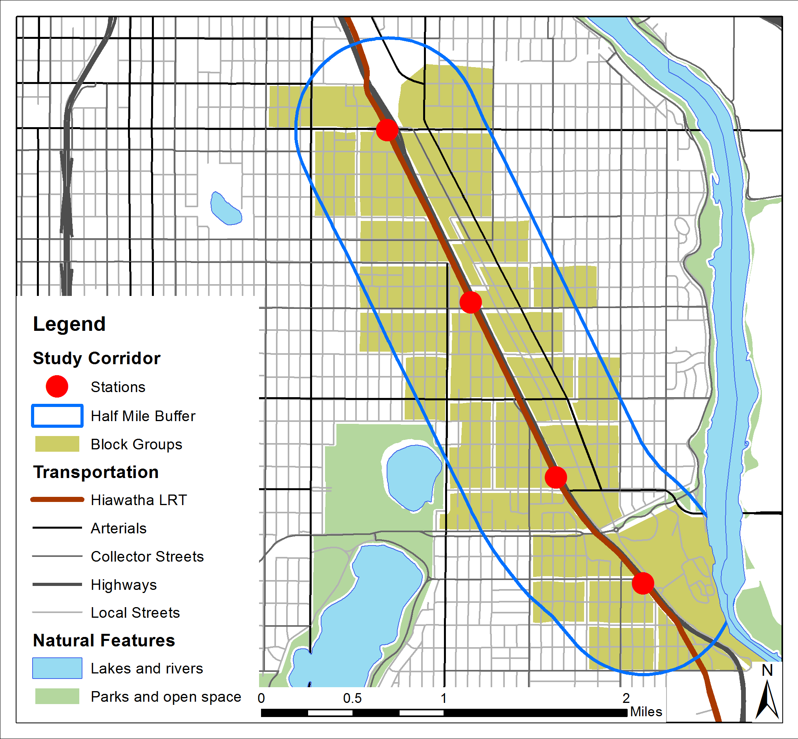
Hiawatha and urban corridors
Match demographics, regional location, built environment, and transit service

Slide 23
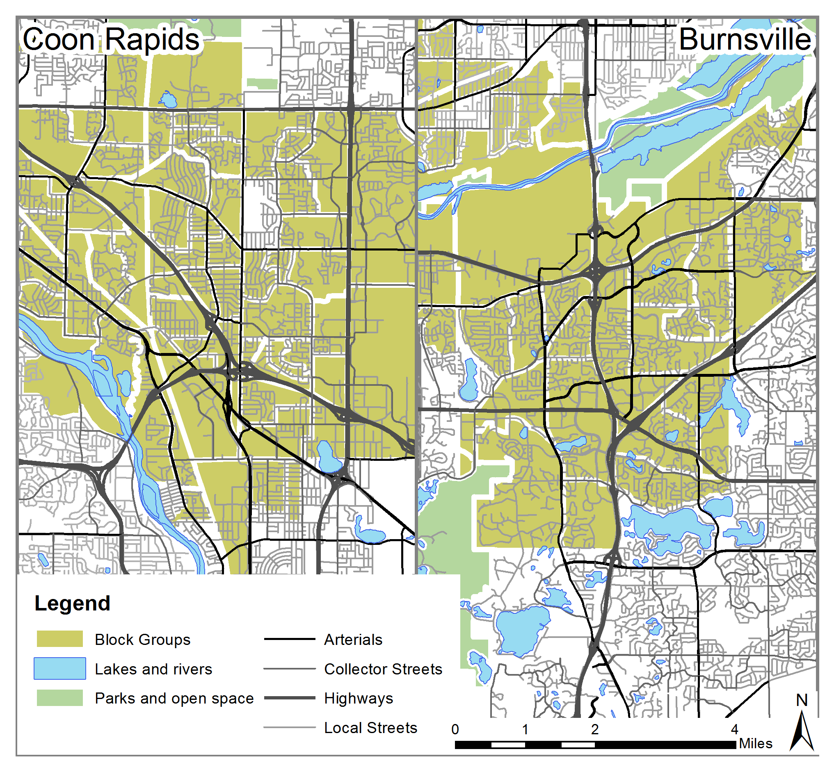
Suburban control corridors
Similar demographics, different regional location, built environment, and transit service

Slide 24
Results
Transit use: cross-sectional
Auto use: cross-sectional
Auto ownership, auto use, and transit use: Quasi-longitudinal

Slide 25
Transit Use
Variables
Commute trips by transit
Non-work transit trips
Propensity Score Matching
Matches cases in different corridors by demographics
Approximates “random assignment” to understand effects of LRT on a random individual
Results
Movers and non-movers analyzed separately
Treatment effect of LRT on transit use

Slide 26
Non-Movers
Destination | Observed Difference | PSM Treatment Effect | Treatment/ Control Ratio
Frequency of commuting by transit | 1.488** | 1.228 * | 65 %
Frequency of using transit for non-work trips | 1.970** | 2.025 ** | 84 %
Movers
Destination | Observed Difference | PSM Treatment Effect | Treatment/ Control Ratio
Frequency of commuting by transit | 0.273 | 0.473 | 12 %
Frequency of using transit for non-work trips | -0.919 | -0.209 | -4 %

Slide 27
Summary
Non-movers: Hiawatha residents take transit more frequently than residents in control neighborhoods.
Movers: There is no significant difference between Hiawatha and control residents in the frequency of using transit for commute and non-work trips.
  In terms of attracting frequent transit users, LRT is not significantly better than buses.

Slide 28
Auto Use
 |  | Urban |  | Suburban
 | Hiawatha | Bloomington | Nicollet | Burnsville | Coon Rapids
N | 430 | 203 | 171 | 165 | 152
VMD | 113 | 121 | 130 | 158 | 188
Notes:
No differences between Hiawatha and Urban

Slide 29
Negbin for auto use
 | M1 |  | M2 |  | M3
Selected variables | Beta | P | Beta | P | Beta | P
Burnsville | 0.379 | 0.000 | 0.218 | 0.021 | 0.008 | 0.930
Coon Rapids | 0.500 | 0.000 | 0.256 | 0.008 | -0.014 | 0.889
Bloomington | 0.070 | 0.377 | 0.151 | 0.064 | 0.060 | 0.461
Nicollet | 0.084 | 0.325 | 0.220 | 0.026 | 0.128 | 0.192
Demographics | with |  | with |  | with
NBHD characteristics
Population density | ― |  | -0.024 | 0.004 | -0.021 | 0.009
Transit route density | ― |  | -8.337 | 0.032 | -7.331 | 0.057
Close to workplace | ― |  | -0.224 | 0.000 | -0.221 | 0.000
Attitudes and preferences
Pro-transit attitude | ― |  | ― |  | -0.121 | 0.000
Transit preference | ― |  | ― |  | -0.084 | 0.003

Slide 30
Summary
Does Hiawatha LRT have a unique impact beyond its station area environment?
  Yes
Is the effect of LRT a result of self-selection?
  Yes
What neighborhood characteristics have an impact after controlling for self-selection?
  Population density and transit route density
  Job access

Slide 31
Quasi-Longitudinal Analysis
Hiawatha LRT → transit/car use of movers
  Compare residents who moved into the Hiawatha and control neighborhoods after 2004
Conceptual model
Move into LRT corridor
Change in
transit use
Change in
# of autos
Change in
car use
Transit improvement

Slide 32
Variables
Travel behavior
  How much do you drive [use transit] now, compared to when you lived at your previous residence? A lot less now → A lot more now [5-point]
Auto ownership
  Change = No. of autos currently – No. of autos just before relocation
Transit improvement factor
  Good public transit service; easy access to transit stop/station
  Perception: how true for current and previous neighborhoods
  Change = current neighborhood – previous neighborhood
  Transit preference (importance when relocating)
  The same two dimensions
  Demographics: income and household size

Slide 33
SEM Results
Move into
LRT corridor
0.27**
Change in
transit use
0.19**
-0.21**
0.43**
Transit improvement
Change in
car use
-0.22**
-0.28*
-0.42**
0.24**
Move into suburban corridor
Change in
# of autos

Slide 34
Dicussion
Influence directly and indirectly through transit improvement
Cao and Schoner (2014)
  Cross-sectional, PSM
  No difference between urban and Hiawatha movers → inconsistency
Why?
  Transit use after moving: urban movers = Hiawatha movers
  Transit use before moving: urban movers > Hiawatha movers
  Change in transit use: urban movers < Hiawatha movers
  Urban movers relocate to match travel preference, similar behavior
  Hiawatha movers relocate for the LRT to better match the preference
  Residential self-selection

Slide 35
Conclusions
Hiawatha LRT does not have an impact on auto ownership.
Hiawatha LRT reduces driving distance after controlling for demographics and neighborhood characteristics.
Moving into the Hiawatha corridor is associated with an increase in transit use and a decrease in driving.
Residential self-selection plays a role in the observed differences.
Neighborhood design affects travel behavior.
Longitudinal analysis is more robust than cross-sectional analysis.

