Slide 1
2016 ABH Presentation
It’s always something – The Rail Renaissance
& the Brave New World
NUTC/TRF Sandhouse Xmas Luncheon!
abh consulting
December 2016
NYC

Slide 2
Deregulation & Vertical Integration Works!

Slide 3
21st Century: the Railroad (equity) Renaissance: From Triumph to Challenged
Rails have well beaten the stock market 2001-2014 – 7 Big Reasons
  Globalization/trade (IM)
  Capex&Productivity&Service
  Pricing & ROI
  Through economic turmoil (manufacturing/energy/markets)
Of Late – “Not So Much” (now regaining “par”)
Energy Impact: real (coal) and hype (CBR)
Visibility & Sentiment change – financial & government/public
Earnings Power (always) misunderstood: Rails beat Street estimates – in the Boom, in the great Recession, and the tepid recovery, in this period
2015: Record margins & results (and Capex and Buybacks/DPS and….) despite the coal - and drought and lukewarm economy, etc….
Rails are still re-gaining market share from the highway despite oil prices (2017?)
Brave New World

Slide 4
The World Turned Upside Down
Looking back, who forecasted this?
In a world with no base assumptions, how does one plan?
Regional Bitterness to ensue
Some commodities will be winners (barley, oats)
Some Losers (goats)
Oh! The humanity!!

Slide 5
New Administration “Promises”
The end of the “War on Coal”
Drill, Baby, Drill (and pipelines, eh!)
Infrastructure (Privately Financed)
Bye-bye Trade (NAFTA)
Get out and stay out! End of the 150-year relationship of GOP & “Big Business” (ask Ford)
War on Regulation (maybe) on Red tape (likely)
Lower taxes
Labor – Who’s driverless, now?

Slide 6
Overview of North American Rail Environment
& Key Issues
Rail Renaissance (and heavy Capex!)is the theme (1980-) 2001-2013;
OVER?? Major Challenges Emerge – Energy Decline (Coal/Oil)
End of the “Commodity Super Cycle” (?); Trade Slowdown; $/FX
Service & Safety Issues; Rereg threats re-emerge
Service & Productivity & Safety (all related to Capex) are a) getting resolved & b) Even More Important Than Ever….
Intermodal performance more critical than ever (recently confusing)
Rails, however, are still re-gaining market share from the highway
Managements, New & Challenged: Visibility, Guidance; Capex & Cash
Asked & Answered: Is M&A the Solution? (What’s the problem?)
What now?
Notes:
Silver Linings?
Service Recovery Trend (Capex Pays Off)
Restoration of the “Grand Bargain” – RR pricing power for improved capacity & service
Less Political Pressure/Improved Productivity
Financial Condition actually pretty strong
“Canadian Model” seen as industry leader
IM latent demand….example: Bi-Modal results
Coming Industrial Buildout (SHIELD); Mexico
Revised MoW Capex (GTMs/Mix) frees CF/2016
Renaissance Discussion Points!
Can Rails Survive – or even thrive – in the NOW?
Or, can rails replace coal (ROI if not OR) with (domestic) intermodal (etc)?
What is the future of industrial/merchandise railroading?
What is the new standard for Capex?
Is M&A the answer?
Future RR Growth Potential
Specific targeted sectors Secular stories (in order)….
Intermodal – international and now domestic
Chemicals/re-industrialization? Near-sourcing/Mexico
Cyclical recovery – housing, autos
Grain & Food – the world’s breadbasket, (un)predictable?
Shale/oil/sand – problem and solution?
Other rail opportunities exist but in smaller scale: for ex: The manifest/carload “problem”
Unitization
Industrial Products/MSW
Perishables
Intermodal Growth Drivers Domestic and International
Globalization
Trade
Railroad Cost Advantages
Fuel prices
Carbon footprint
Share Recovery from Highway
Infrastructure deficit & taxes (public vs privately financed network!)
Truckload Issues; regulatory issues, driver issues

Slide 7
Close Correlation Between RR ROI and Reinvestments
RR ROI** (left scale)
*Capital spending + maintenance expense. **Net railway operating income / average net investment in transportation property. Data are for Class I railroads. Source: AAR
16

Slide 8
Notes:
8

Slide 9
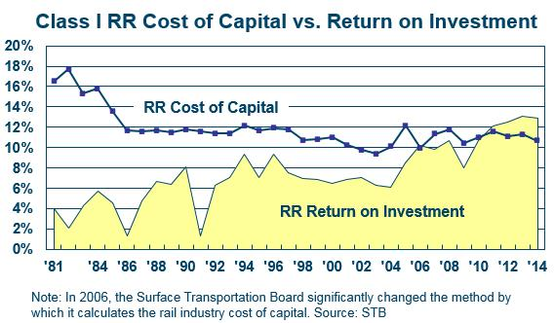
Returns Finally Justify the Massive Expenditures – But Do Future Prospects??

Slide 10
Railroads Help Keep Coal-Based Electricity

Slide 11
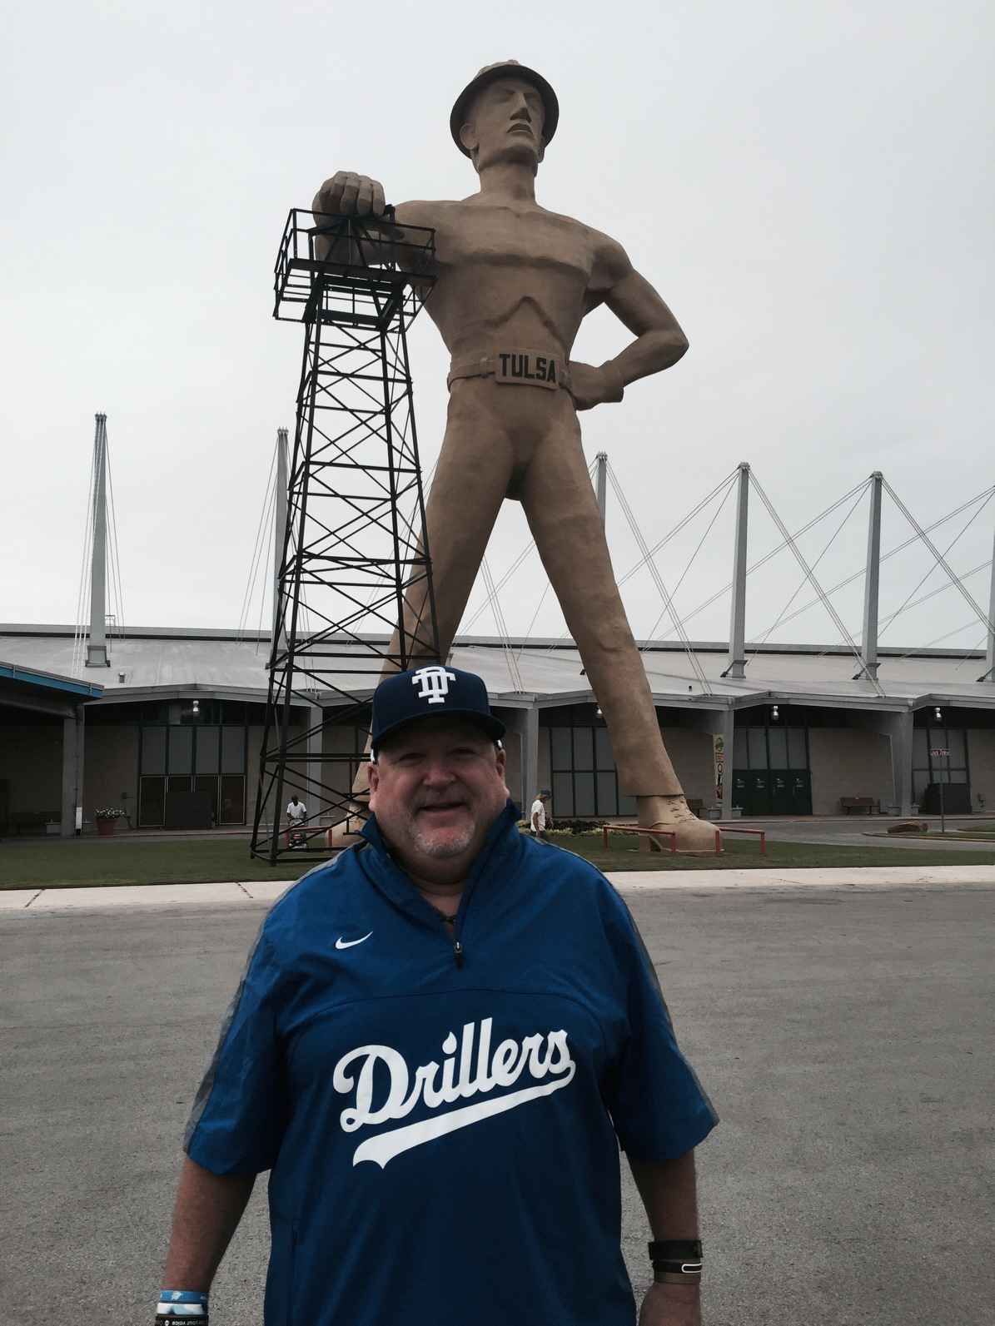

Slide 12
Shale-Related Rail Traffic
Relative to Coal Loadings
4 Qtr. Avg. 1,754,908
-365,073
3 Qtr. Avg. 1,389,835
+127,134
4 Qtr. Avg. 204,778
4 Qtr. Avg. 77,644
Source: Surface Transportation Board, PLG Analysis March 2016

Slide 13
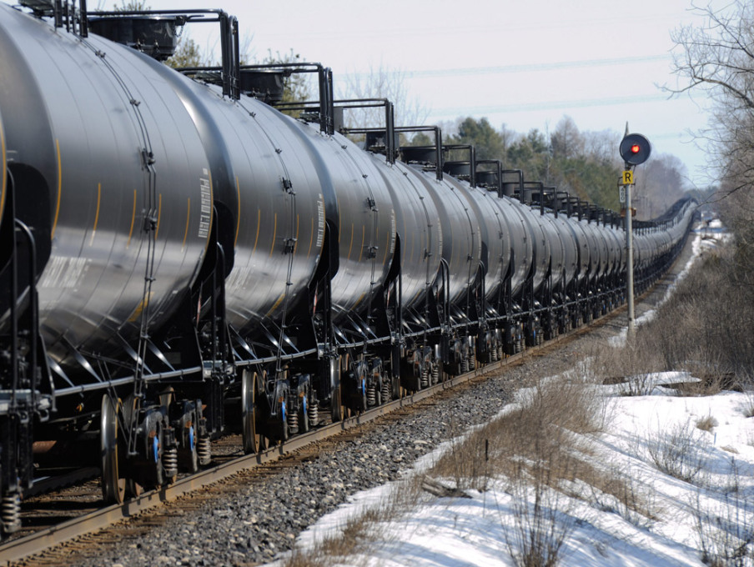

Slide 14
New Energy Rail Growth Story –
Crude & Frac Sand
Source: AAR (Freight Commodity Statistics)

Slide 15
Silver Linings?
Service (& Safety) Recovery Trend (Capex Pays Off)
Productivity (& volume?) Inflection
Restoration of the “Grand Bargain”
Reduced (N/T) Political Pressure
Coal “stabilization” (Part Two)??
IM (etc.) latent demand….Bi-Modal results; Ag
Gas-fired Industrial Buildout; Southbound migration of industry
Revised MoW Capex (GTMs/Mix) frees CF/2017+

Slide 16
The “Grand Bargain”
In return for higher prices (& ROI), rails spend, increase capacity & improve service (2005-2012) – The unstated “Grand Bargain”
Rails gain pricing power (~2003) & F/S
Rails (re) Gain Market Share
Rails Spend Cash “Disproportionately” on Capex (~18-20% of revenues)
Promotes “Virtuous Circle” – all stakeholders benefit
Under challenge, perceived and real

Slide 17
Future Growth Potential (Revised)
Secular stories and specific targeted sectors (in order)….
  Intermodal – international and now domestic
  Chemicals/re-industrialization? Near-sourcing/Mexico
  Cyclical recovery – housing, steel, autos
  Grain & Food – Exports up 10% this CY? NA still the world’s breadbasket, but obviously (un)predictable?
  Car-load merchandise – capacity available!
  Shale/oil/sand – demonstrated “flexibility”
  Other rail opportunities exist but in smaller scale: for ex: The manifest/carload “problem”
  Unitization
  Industrial Products/MSW
  Perishables

Slide 18
Issues for RR & Intermodal 2017-21
Return to Growth?
Fight over Capital – MoW vs Buybacks?
M&A Fight fallout effect on Capex?
RR Pricing Power Still?
Factors: Oil Prices, Consumer Spend/GDP, Truck Capacity
Infrastructure Advantage (vs subsidized highway)
Trade and the Panama Canal impacts? NAFTA?
Rail Service (& Safety) Improvements
Coal stabilization
Driverless beats One Man Crews to the market?

Slide 19
Railroad Respond to the Challenges
“Traditional Response” – cost cutting
Strategic response to secular changes – coal
Capex response – TBD (stakeholder division?)
Radical change (ex. M&A)?
(Continue to) Focus on growth areas
Retain concentration on Service & Productivity
Innovate! (“regain tech ‘mojo’’)

Slide 20
Class I Railroad Employment
2008 2009 2010 2011 2012 2013 2014 2015 2016
Source: STB
SLIDE 20
Notes:
• Personnel are clearly a key determinant of rail capacity and service, and RRs have been aggressively hiring and training new employees.
• Like every other major U.S. industry, freight railroads saw a reduction in employees during the “Great Recession,” but there has been a significant recovery in rail employment since then, including a sharp surge since the beginning of 2014 when existing service problems began in earnest.
• Since mid-2015, a decline in rail employment due to lower rail traffic levels.

Slide 21


Slide 22
Railroad Philosophy
Critical to the “RR Renaissance” has been Capex
Private vs public capital (failing US infrastructure)
Capex sparked by growth and ROI prospects – examples: IM, CBR
“Open Access” antithetical to this….right?
Is a RR its Network (Class One belief) OR is it its Operators (Hunter)??
Cult of the OR vs ROIC; short-termism

Slide 23
2016+ Capex
Most Important Decision Period in Years
Capex down across the board (annopunced average -16%!) – except CN!
Further cuts (NS, UP) and hints (CN) during the year (FY -20%?)
Coal: “Stranded Assets”? NS selling segments….CSX of Tomorrow
Coal/Mix: Reduced Gross Ton Miles=Reduced Maintenance of Way?
Yet remember: Service & Safety are even more critical to future RR success
Changing mix of capex?
Changing %revenues (16%)?
PTC Extension resolution – more to develop? ECP?

Slide 24
Railroads: Far More Capital Intensive Than Other Industries
Capital Expenditures as a % of Revenue: 2014
Class I RRs
Nonmetallic Minerals
Computers
Wood Prod.
Motor Vehicles
Food
Sources: Census Bureau, AAR
Notes:
• Railroads are near the top among all industries in terms of capital intensity.
• For example, in 2013, Class I railroads spent 18% of their revenue on capital expenditures. The comparable figure for the average U.S. manufacturer was 3%.

Slide 25
Railroads Help Keep Coal-Based Electricity
Railroads Are Far More Capital Intensive Than Most Other Industries
Notes:
• Railroads are near the top among all industries in terms of capital intensity.
• For example, from 2004-2013, Class I railroads spent 17.2%, on average, of their revenue on capital expenditures. The comparable figure for the average U.S. manufacturer was 2.8%.

Slide 26



Maintenance Spending Remains Durable
Select Class I Capex Budgets
$ in Billions
$5.0
4.0
$4.3
 | $2.4 | $3.7
 |  | (18%) (1%) | $1.9
 | $1.9 |  | $1.8
3.0
$2.8
$2.9
$1.4 | +4% +7% | $1.4
$1.4 |  | $1.5
$2.5
$2.4
2.0
1.0
$1.3 | (10%) +2% | $1.2
$1.2 |  | $1.2
0.0
2015
2016B
2015
2016B
2015
2016B
Infrastructure Other Capex
Note: CN in CAD. SOURCE: Greenbriar!

Slide 27
Railway Night Sweats
Politics (& Regulation)
Trade – Globalization over?
(Specifically) NAFTA – which impacts S….&N!
Driverless – AV beer runs! (ahh the irony)
Amazon – who isn’t scared?
3-D Printing – good enough for combat?
Short-Termism/Over-reactions
Capex and FCF planning

Slide 28
Take-Aways From RailTrends16
Good: IM & (especially) Merchandise Opportunities and near-term inflection; plastics, Ag,
Maybe Good: reduced taxes and regulation? Infrastructure?
Bad: Railcar production, coal (war is over)
Ugly: Visibility, Trade
Really, really ugly? AV trucking
Have Faith & Innovate: Canadian National

Slide 29
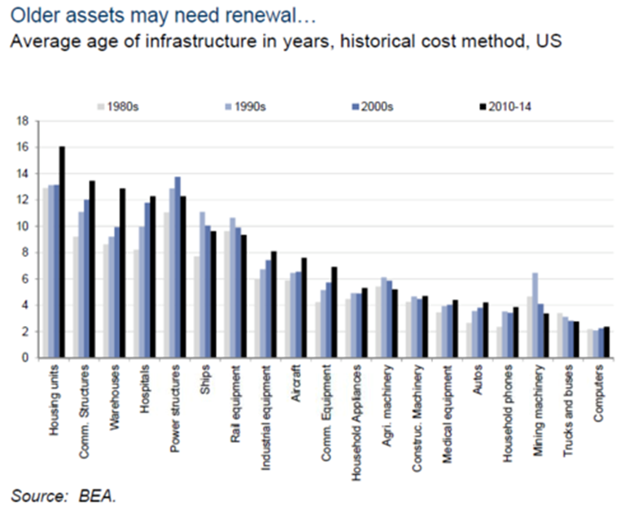

Competitive Advantage: RR Capex vs Aged National Infrastructure

Slide 30
ABH Consulting/www.abhatchconsulting.com
Anthony B. Hatch
1230 Park Avenue
New York, NY 10128
(917) 520-7101
ABH18@mindspring.com
www.railtrends.com
Notes:
30

